Slide 1
AWS
AWS-AMAZON WEB SERVICES:
IS SUBSIDARY OF AMAZON THAT PROVIDES ON-DEMAND CLOUD COMPUTING PLATFORMS AND API’S TO INDIVIDUAL, COMPANIES AND GOVERNMENTS ON A METERED
PAY AS YOU GO BASIS.

Slide 2
WHY AWS?
NEED : I WANT TO DEVELOP SOMETHING , MAY BE AN APPLICATION OR A SOFTWARE.
I MAY BE IN A NEED OF:
SERVER FOR PROCESSING REQUESTS
DATABASE
STORAGE
AND MANY FEATURES SUCH AS ML, AI ETC..,
WHAT GUARANTEE IS THAT IT WILL GET SUCCEEDED?
WILL THE MONEY THAT I INVEST WON’T GO WASTE?
SOLUTION :
YES THE SOLUTION FOR ANY OF THE QUESTIONS WE GET TO DEVELOP SOMETHING WOULD ABSOLUTELY BE
AWS

Slide 3
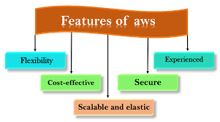
AWS
AMAZON WEB SERVICES ESTD.2002
FLEXIBILITY
COST EFFECTIVE
SCALABLE AND ELASTIC
SECURE
EXPERIENCED

Slide 4
flexibility
it enables us to select the operating system, programming language, web application platform,
Database and all other things I may need for my software.

Slide 5
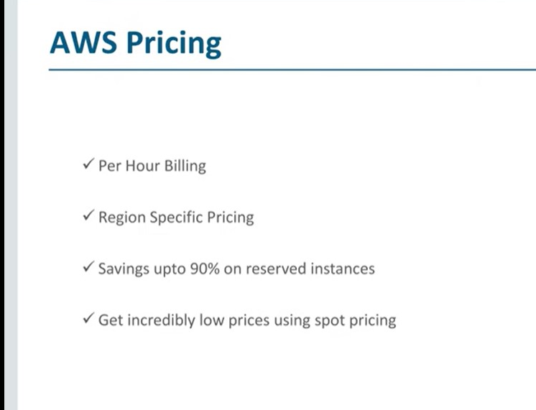
COST-EFFECTIVE
IT ALLOWS A VARIETY OF FLEXIBLE COSR EFFECTIVE PRICING OPTIONS .
ON-DEMAND INSTANCES ALLOWS YOU TO PAY FOR COMPUTECAPACITY BY THE HOUR,
WITH NO MINIMUM
COMMITMENTS REQUIRED

Slide 6
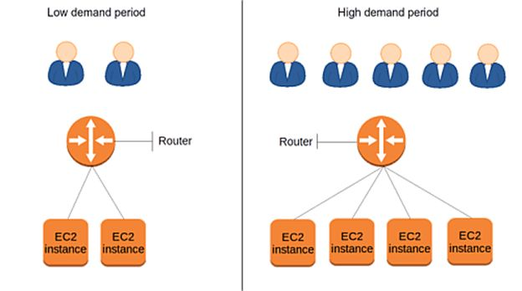
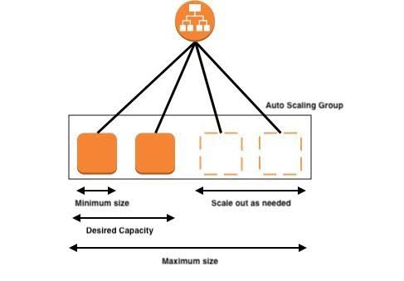
SCALABLE AND ELASTIC
IT MONITORS OUR APPLICATIONS AND AUTOMATICALLY ADJUSTS CAPACITY TO MAINTAIN STEADY, PREDICTABLE PERFORMANCE AT THE LOWEST POSSIBLE COST.

Slide 7
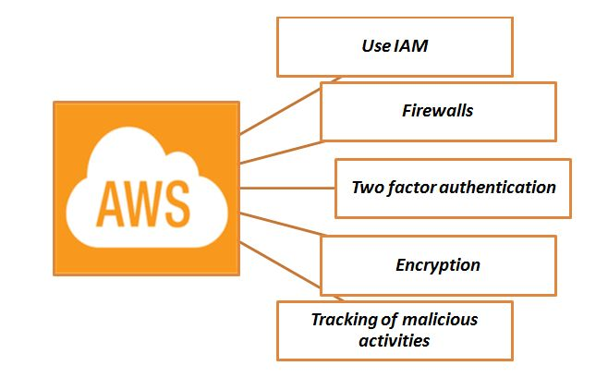
SECURE
IT PROVIDES SERVICES THAT HELPS US TO PROTECT OUR DATA, ACCOUNTS, AND WORKLOADS FROM UNAUTHORIZED ACCESS.

Slide 8


EXPERIENCE
AWS EXPERIENCE CONSISTS OF PHYSICAL AND VIRTUAL SPACES TO EXPERIENCE AND LEARN MORE ABOUT AWS CLOUD.
IT CONSISTS OF LOCAL AWS EXPERTS AND PARTNERS TO HELP AND GROW BUSINESS.
WORK PLACE AT MADRID: AT MUNICH:

Slide 9
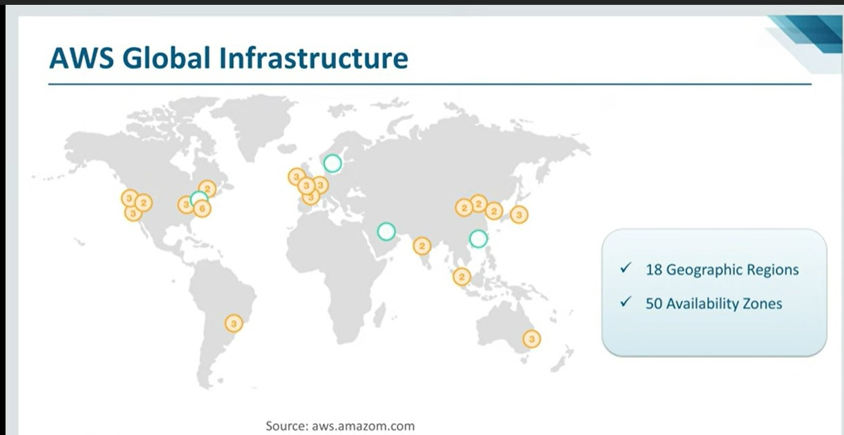
GLOBAL INFRASTRUCTURE
CONTAINS MANY GEOGRAPHIC REGIONS AND ZONES IN ORDER TO PROVIDE UNINTERRUPTED SERVICES FOR THE USERS.

Slide 10
GLOBAL MARKET
AWS HAS A GREAT DEMAND NOW A DAYS IN PRESENT DAY MARKET.
AN AWS CERTIFIED PROFESSIONAL CAN BE PLACED IN MANY OF THE FIRMS ACROSS THE GLOBE WITH AROUND
HIGHEST PACKAGE OF $1,27,000
( 1 CR IN INDIAN CURRENCY )
MANY PLLATFORMS ARE AVAILABLE ONLINE TO GET THROUGH AWS CLOUD COMPUTING SERVICES

Slide 11
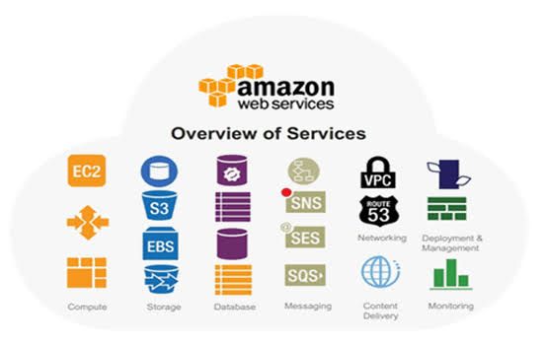
OVERVIEW OF ALL THE SERVICES BEING PROVIDED

Slide 12
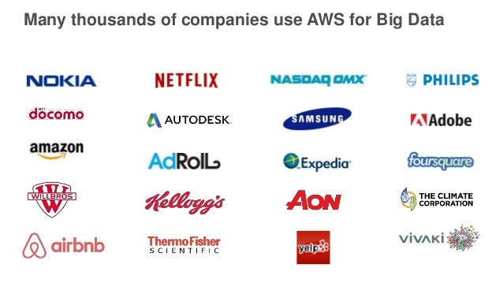
COMPANIES USING AWS

Slide 13
DEMAND IN INDIA
As per Glassdoor, the average AWS salary in India starts from Rs. 6,07,000 per annum.
It could even start at Rs. 3,83,000 per annum if you don’t get a chance to work at a top firm or don’t have relevant experience.
It could reach a high of Rs.1,537,000 per annum depending not only on the company you are employed at but also your location.

Slide 14
SUMMARY
AWS- AMAZON WEB SERVICES: CLOUD COMPUTING PLATFORM
FEATURES: SCALABLE, COST EFFECTIVE, SECURE, FLEXIBLE
PROVIDES: DATABASE, SECURITY, SERVERS, RDBS, REMOTE COMPUTING, STORAGE, ANALYTICS.
MAIN ADVANTAGES: BILLING, EASY USAGE, FEATURES, UNINTERRUPTED SERVICES WITH MANY WAREHOUSES.

Slide 15
REFERENCES:
GOOGLE: AWS OFFICIAL WEBSITE
YOUTUBE:
AWS EXPLAINATION 1
AWS 2
AWS 3
AWS LEARNING PLATFORMS:
UDEMY
TCS ION DIGITAL LEARNING HUB
COURSERA

